Slide 1

Event Streaming
Oskar Dudycz

Slide 2
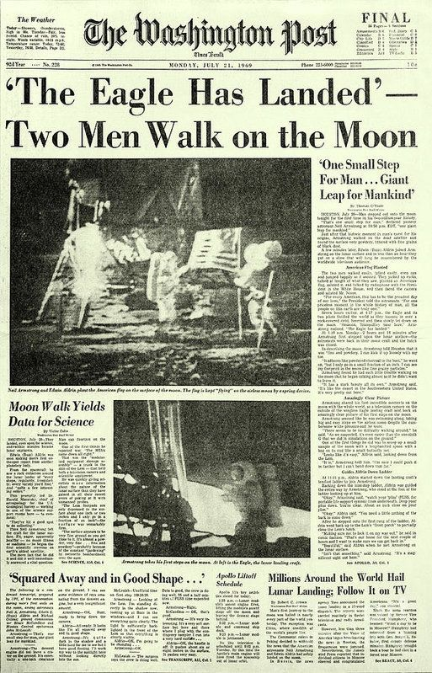
What is an event?
EventS represent
Facts
of information

Slide 3
What is an event?
EventS Happened
In The PAST

Slide 4
What is an event?
Events
Are
Immutable

Slide 5
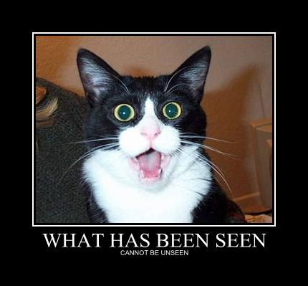
What is an event?
Events Can
Be
Ignored
But Cannot be
RETRACTED

Slide 6
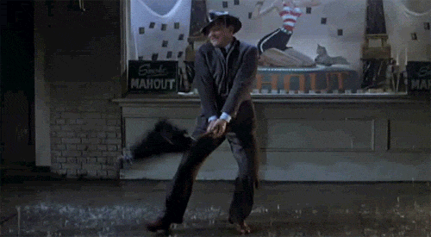
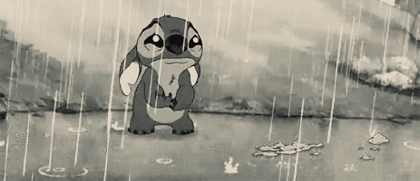
What is an event?
Events Can
Be INTERPRETED
Differently

Slide 7

What is an event?
Events are
Messages

Slide 8
What is a Command?
Method
Action
Request
Also message

Slide 9

COMMAND = intent EVENT=Fact

Slide 10
Commands vs Events
All about intent.
Directed
Single addressable destination
Models personal communication
Distributed focus
Command & Control
Intentless
Anonymous
Just happened – for others (0-N) to observe
Models broadcast (speakers corner)
Local focus.
Autonomy

Slide 11
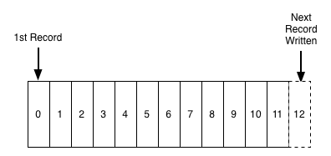
What is an event STREAM?
ORDERED SEQUENCE of EVENTS
COLLECTION
QUEUE

Slide 12

What is an event STREAM?
ORDERED SEQUENCE of EVENTS
COLLECTION
QUEUE

Slide 13
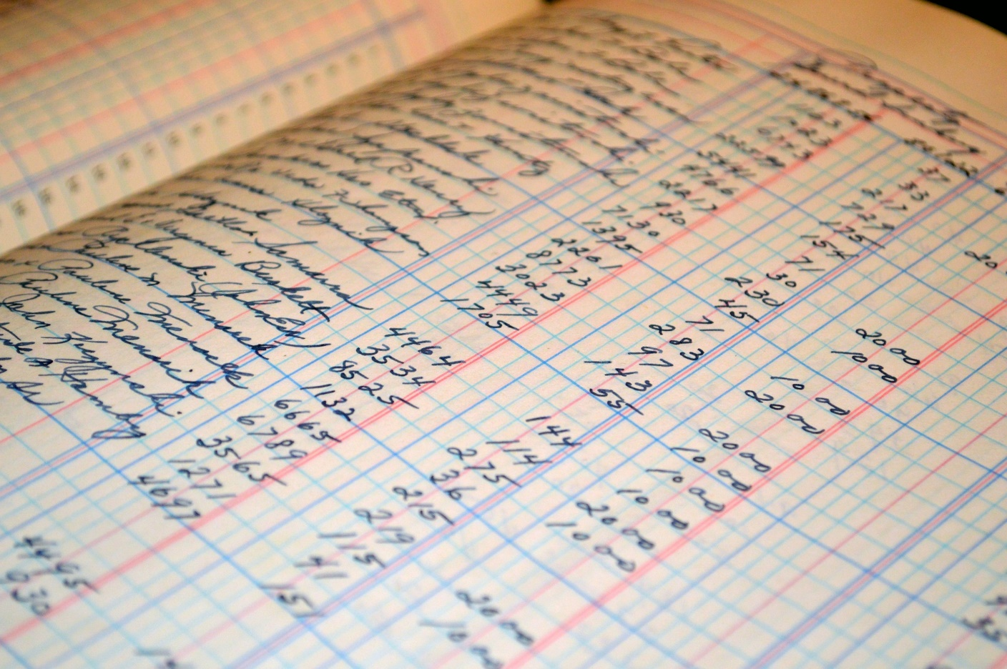
What is an event STREAM?

Slide 14
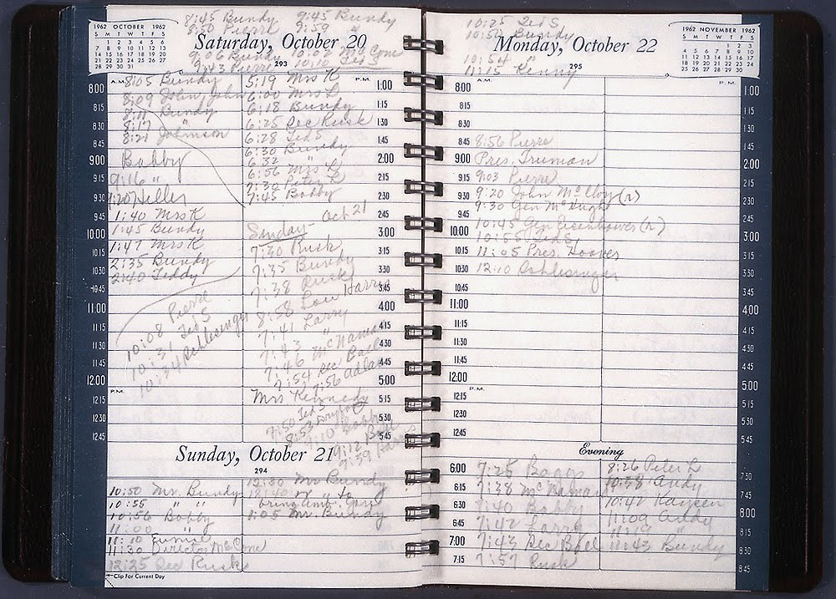
What is an event STREAM?

Slide 15
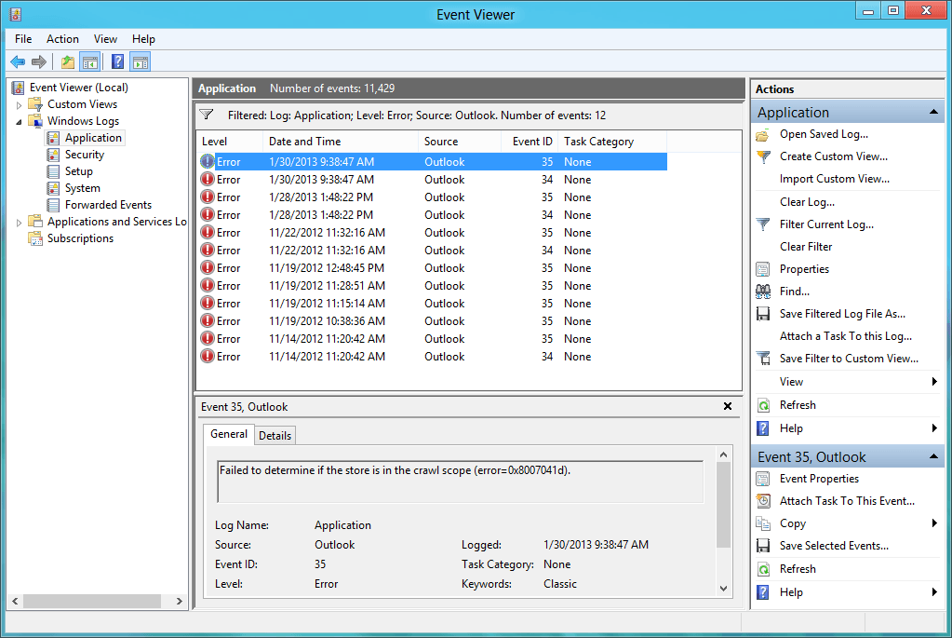
What is an event STREAM?

Slide 16
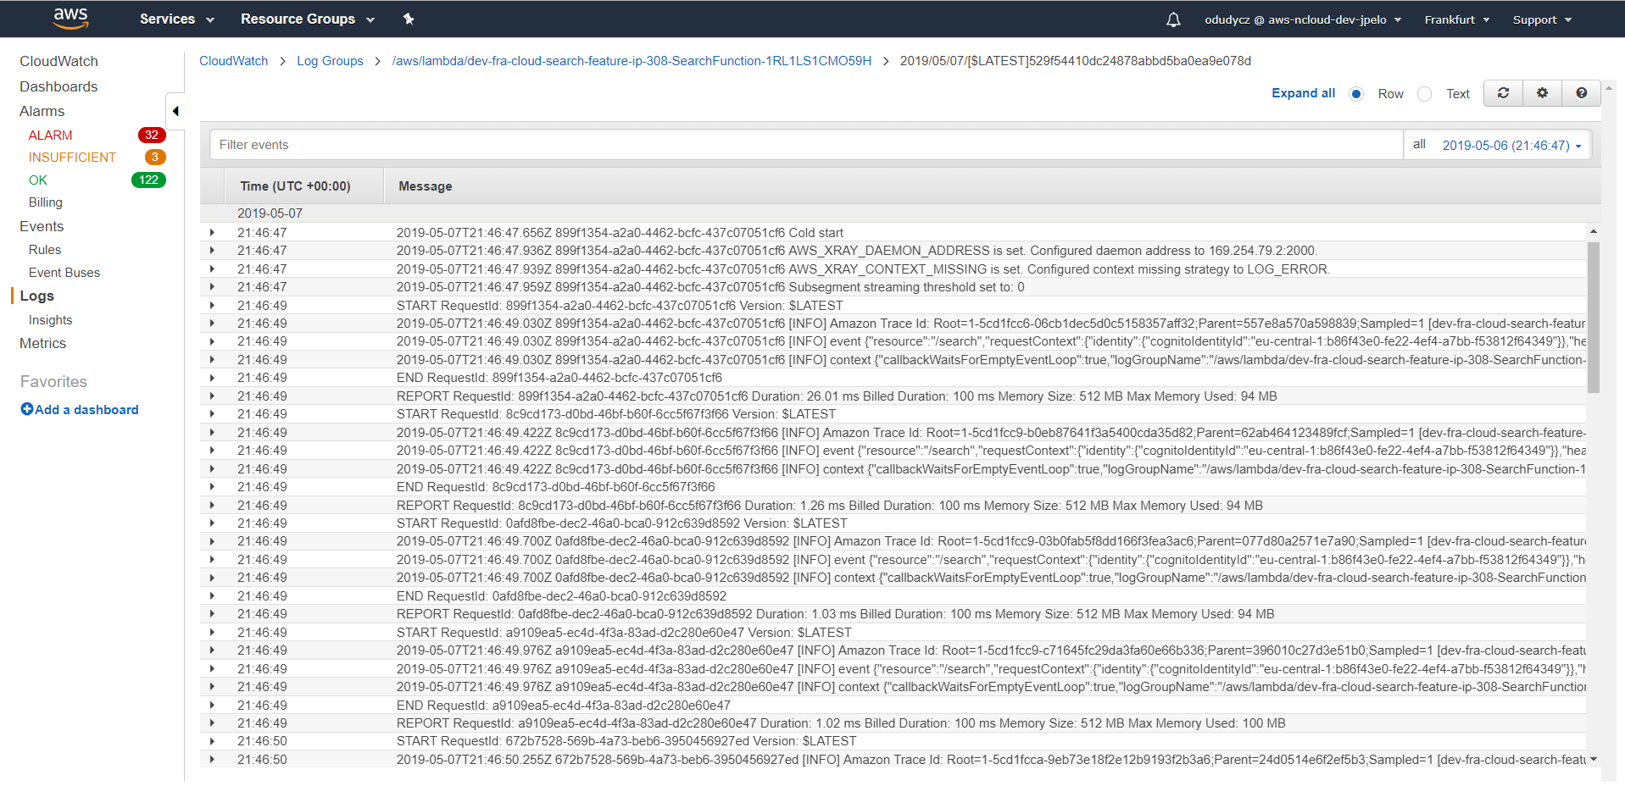
What is an event STREAM?

Slide 17
What is an event STREAM?
EVENTs QUEUE:
USER VIEWED PAGE
CUSTOMER X Purchased product Y
JOB (commands) QUEUE:
Please send this email to John
Please charge this Credit card

Slide 18
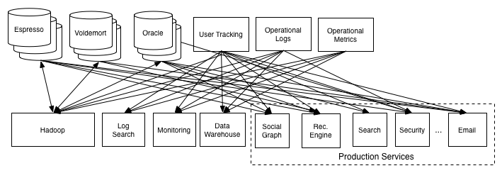
THE ORIGINS
LINKED in

Slide 19
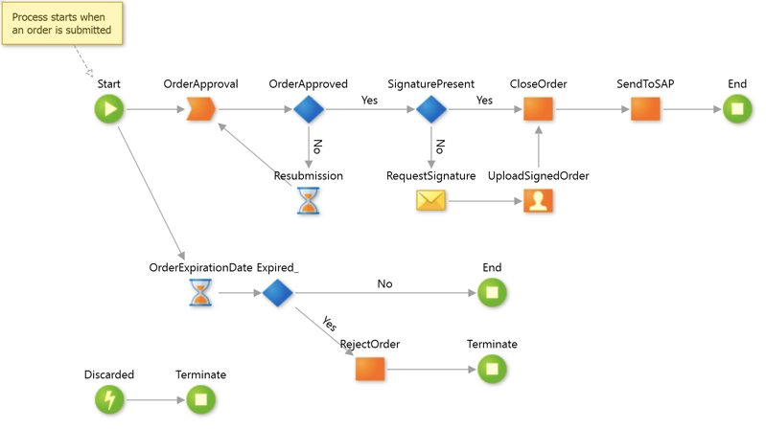
THE ORIGINS

Slide 20
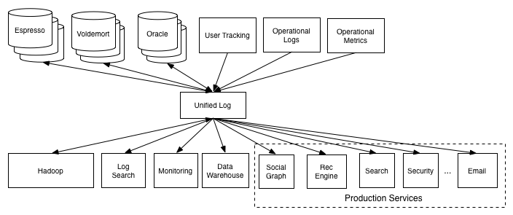
THE ORIGINS
LINKED in

Slide 21
THE ORIGINS
{
eventType: “ProjectCreated”,
Version: 1,
Timestamp: ‘2019-05-08”
Data: {
ID: 134596,
Name: “Apollo 13”,
ManagerID: “Tom.hanks@Hollywood.com”,
}
}

Slide 22
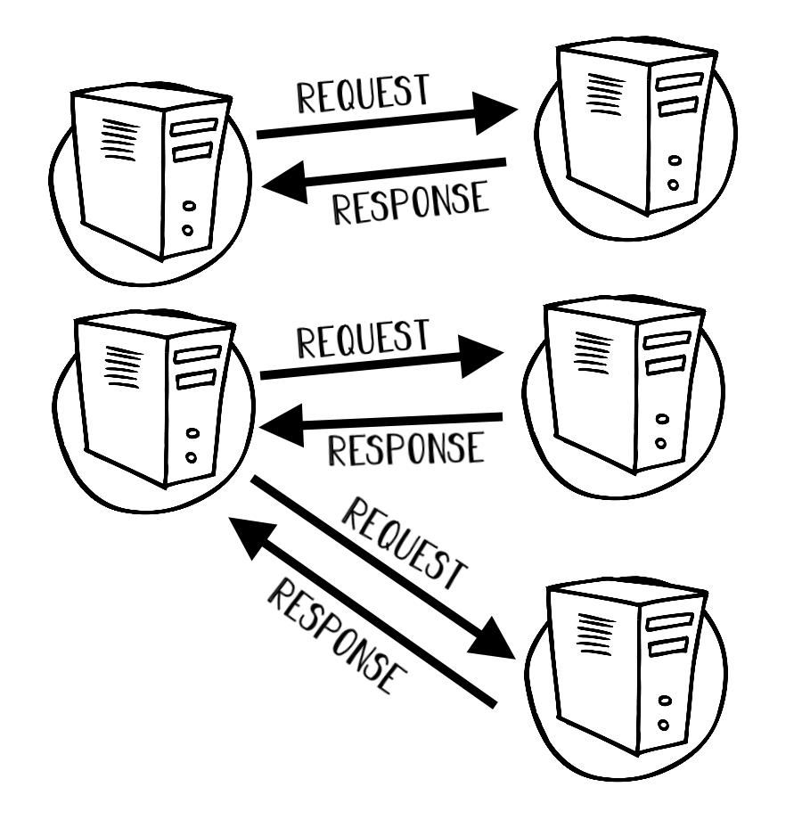
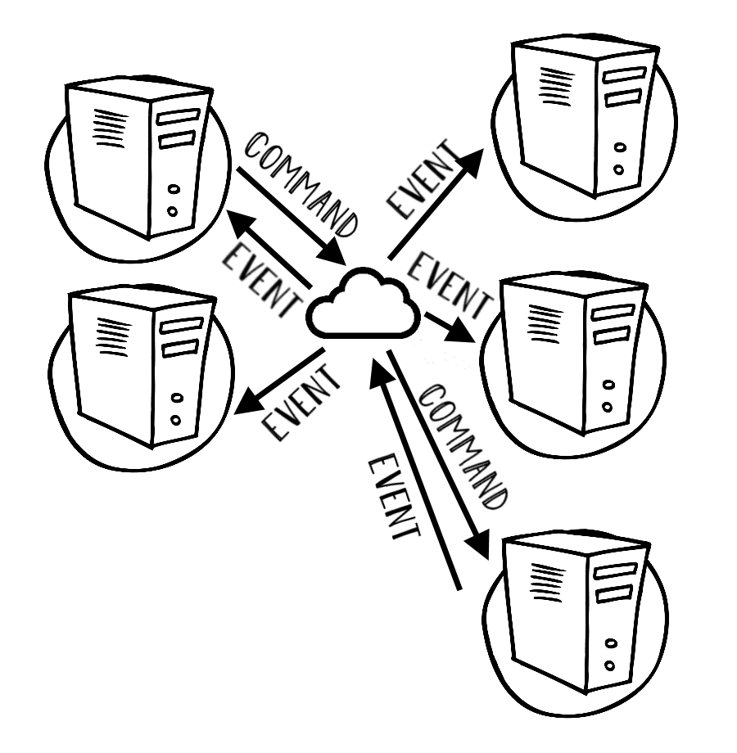
Message BUS
Decoupled Logic
Publish/subscribe Semantic
Synchronous Communication
Direct Connection (RPC, P2P, ETC.)

Slide 23
Message BUS

Slide 24
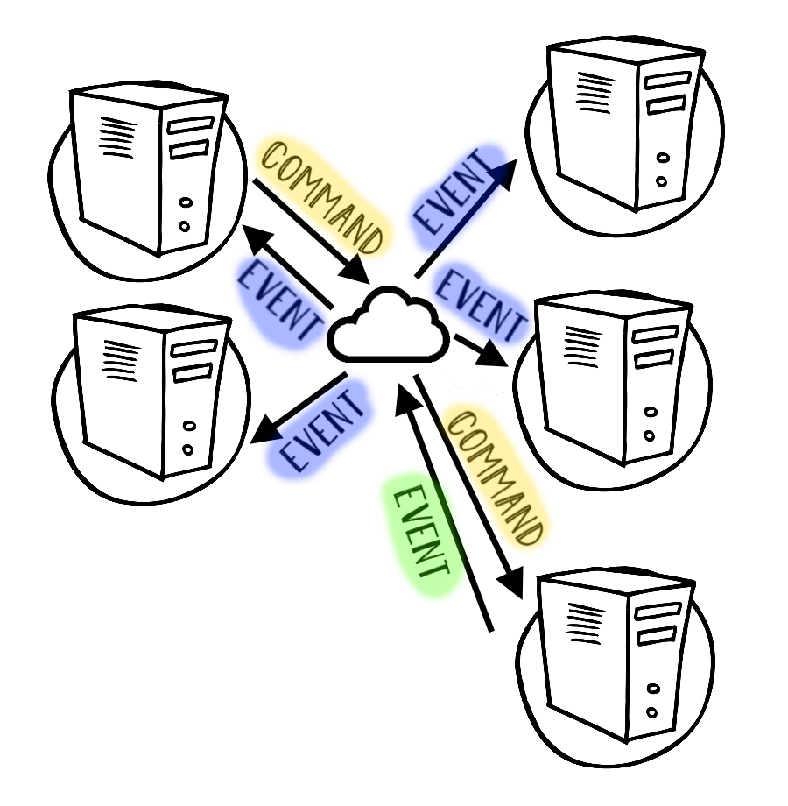
Message BUS

Slide 25
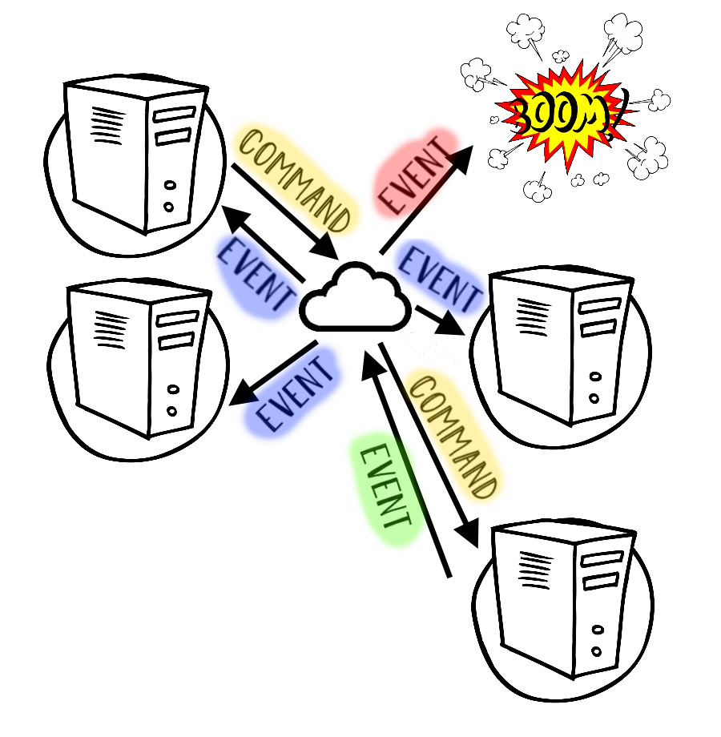
Message BUS

Slide 26
Message BUS

Slide 27
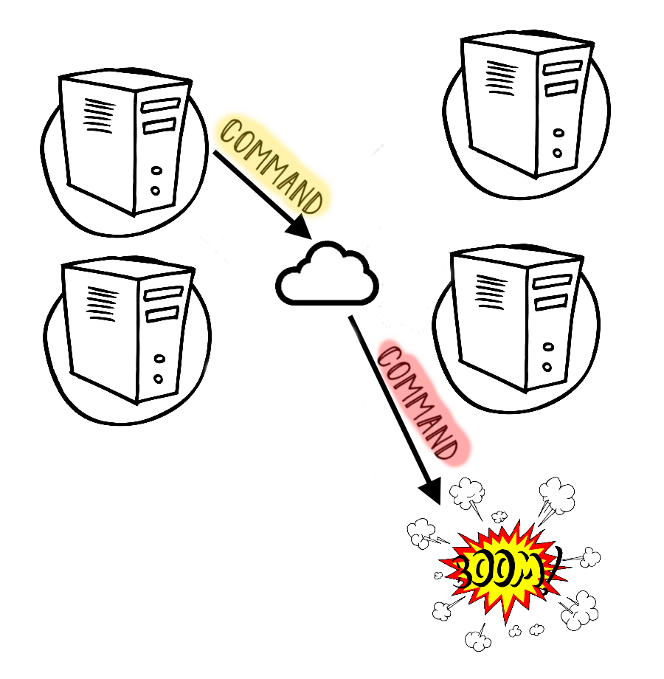
Message BUS

Slide 28
Streaming system
Decoupled Logic
Publish/subscribe Semantic
Asynchronous Communication
REPLAY Mechanism
Built IN Storage (DURABILITY)

Slide 29
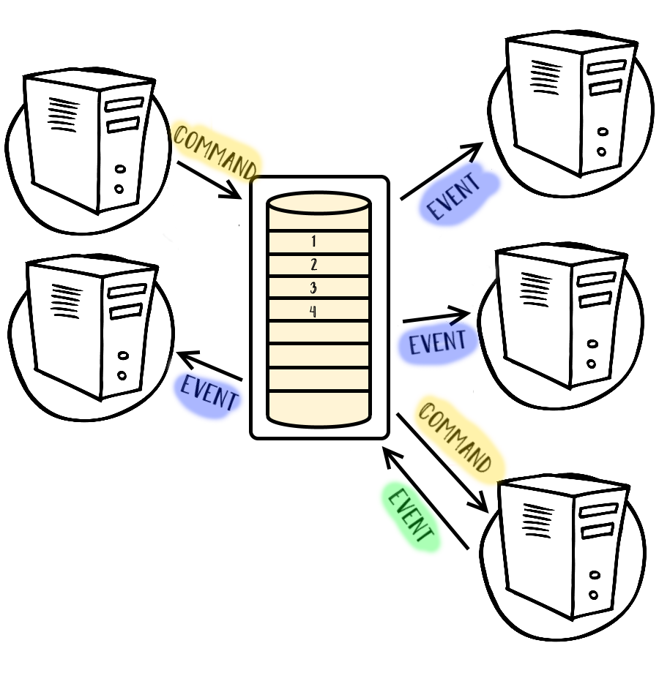
Streaming system

Slide 30
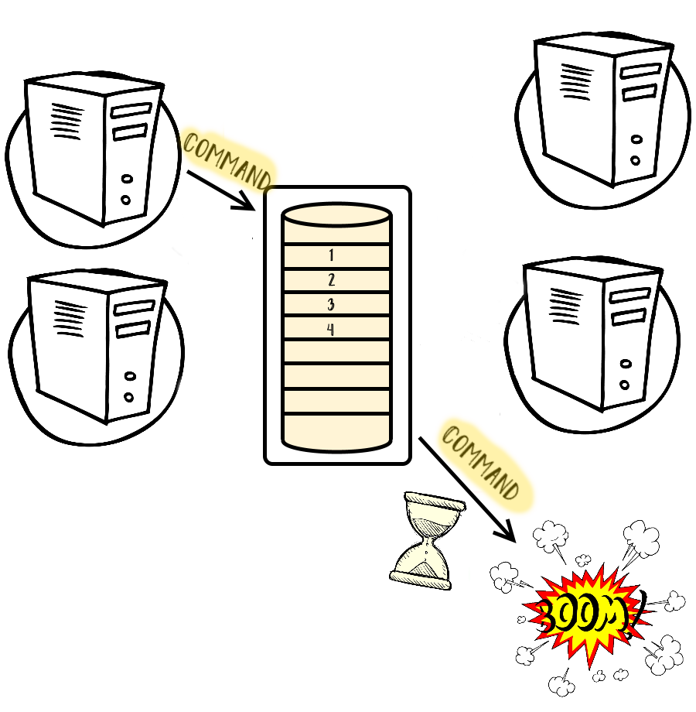
Streaming system

Slide 31
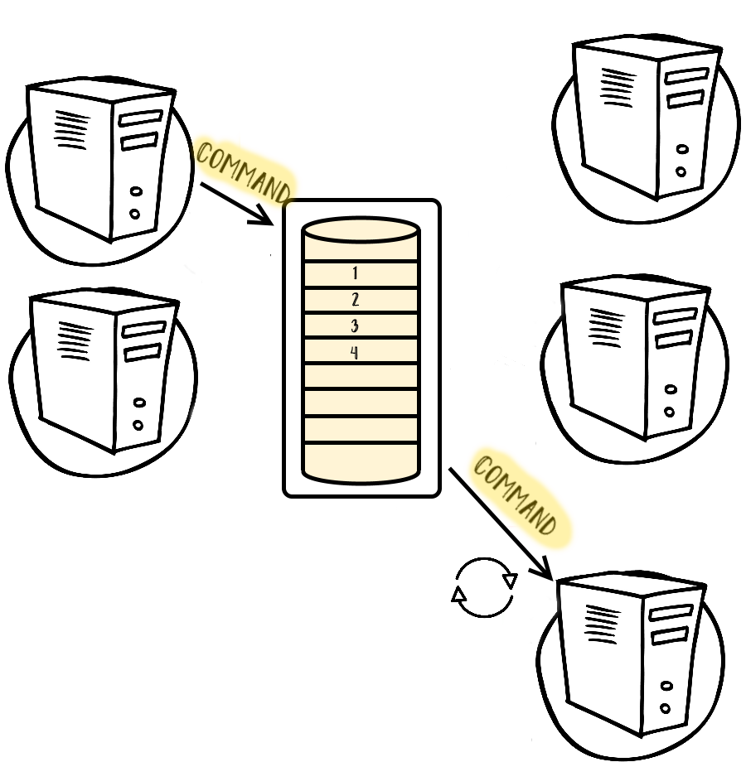
Streaming system

Slide 32
Streaming system

Slide 33
Streaming system

Slide 34
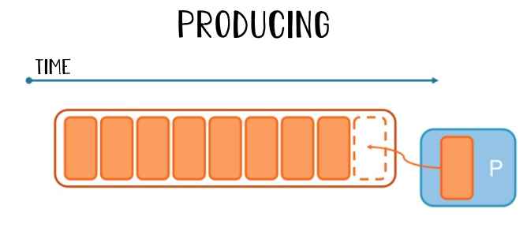

Streaming system

Slide 35
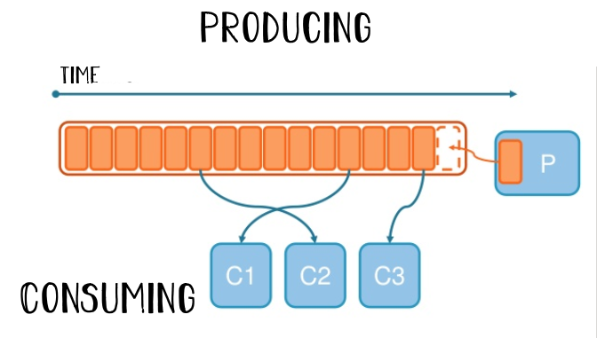
Streaming system

Slide 36
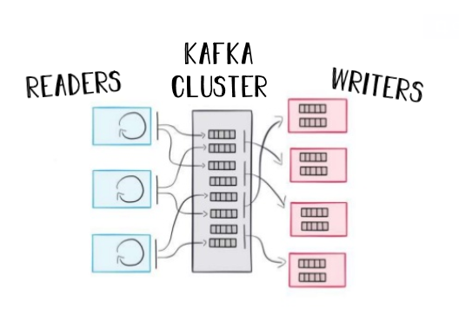
Streaming system

Slide 37
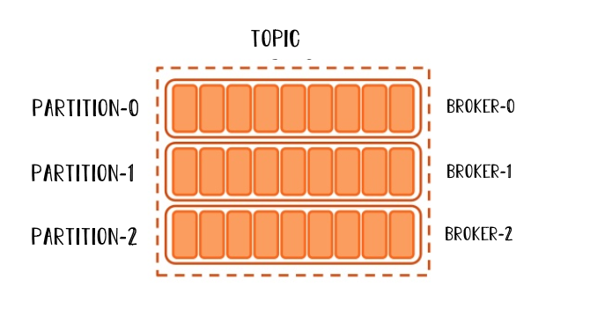
Streaming system

Slide 38
Event driven services
Receive and react (or not) to facts that are coming it’s way
Publish new facts (asynchronously) to the rest of the world

Slide 39
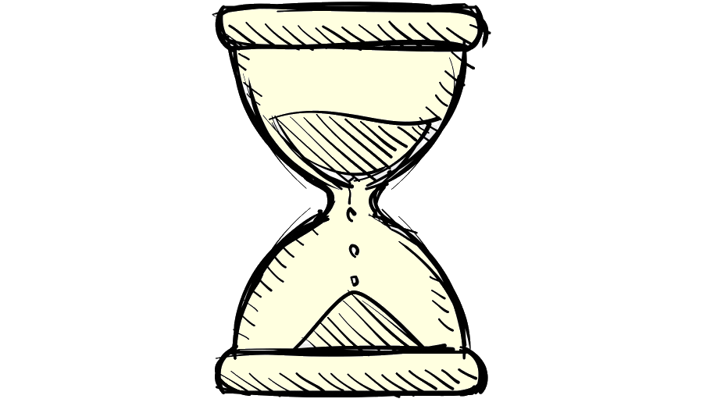
Eventual consistency
?

Slide 40
Idempotency

Slide 41
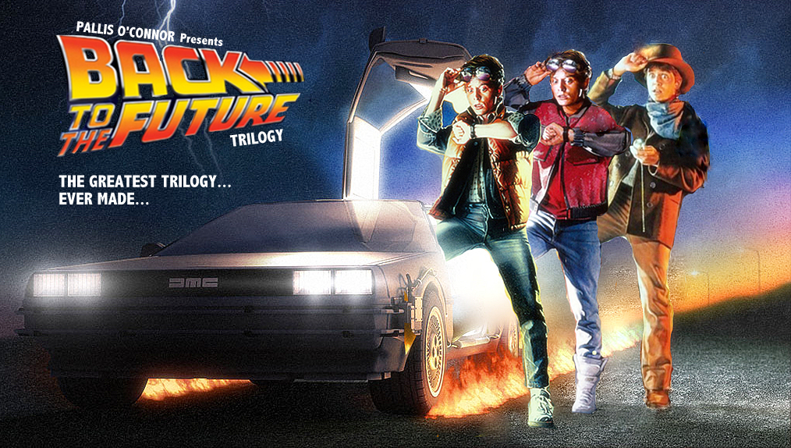
ORDERING

Slide 42
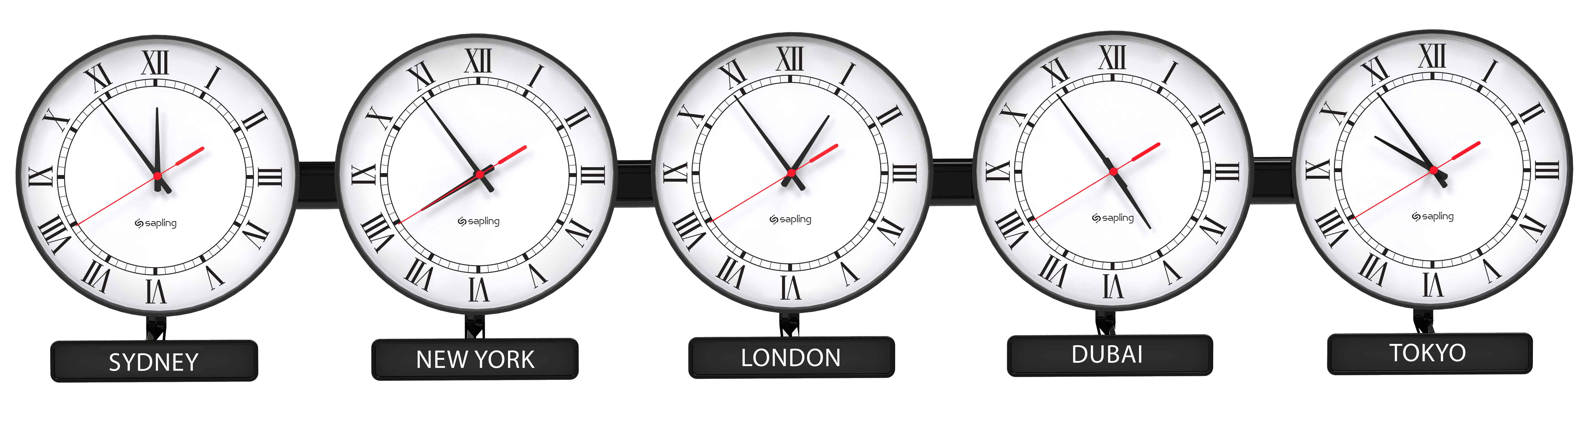
How soon is now?

Slide 43
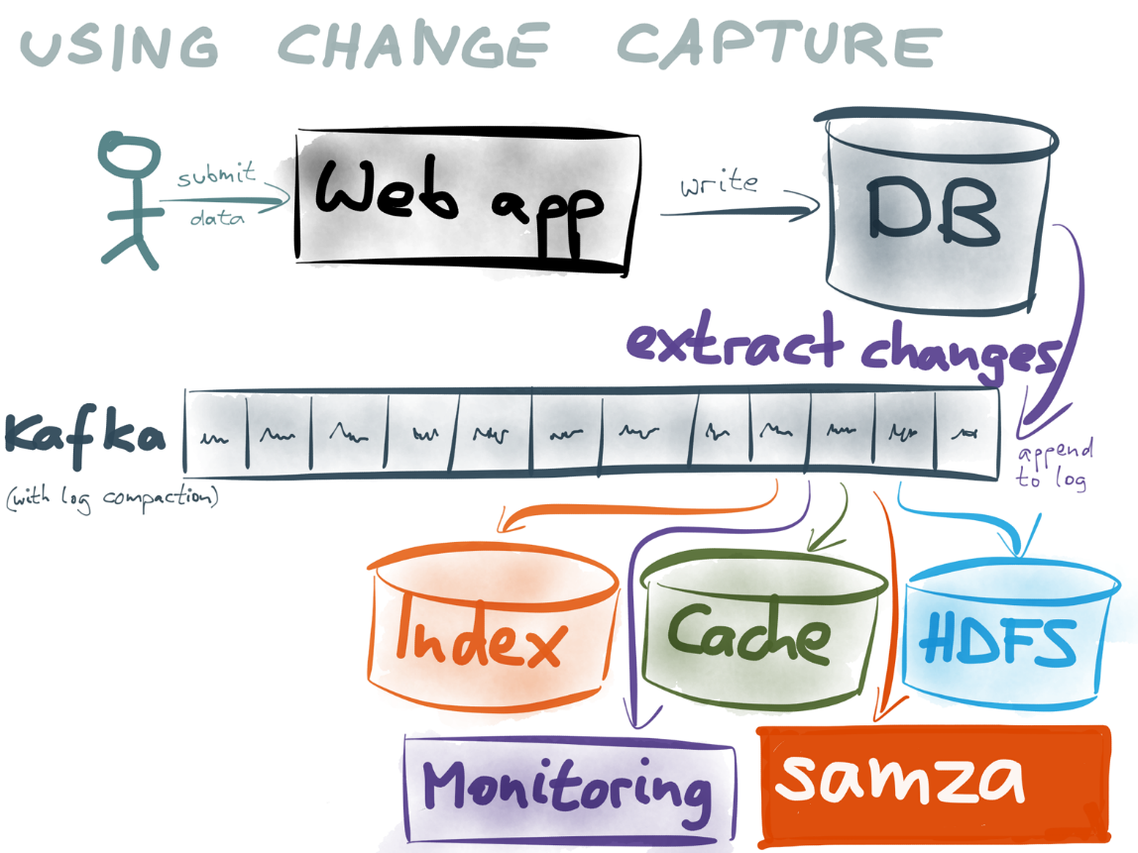
MODERNIZING Current APP

Slide 44
EVENTS CAN Lead to BETTER Certainity

Slide 45
EVENTS Help US Manage Failure instead avoiding it

Slide 46
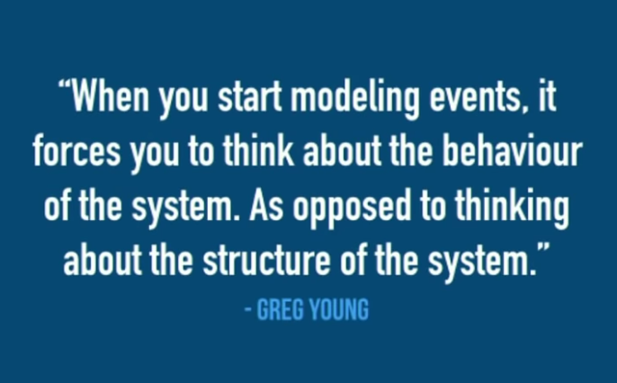
Quotes

Slide 47
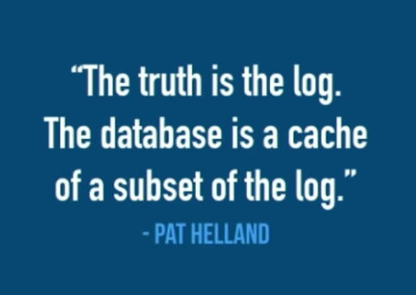
Quotes

Slide 48
Information has latency There is no Now Information is always From the past

Slide 49
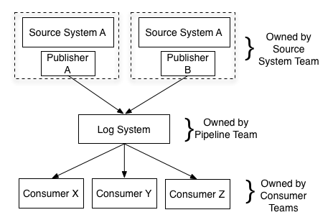
Events Give better boundaries And Flexibility

Slide 50



SOMe Numbers
is processing over>4.5 trillion messages/Day
is processing over 6 Petabytes/Day
OTHERS ALSO ARE NOT FAR BEHIND:

Slide 51
EVENT STREAMING
HELPS YOU:
Predictability
MOVE FASTER toward Resilent AND scalable architecture
DESIGN AUTONOMous services
Be Fault Tollerant
Balance certainity and uncertainity

Slide 52
